Slide 1





Next JS

Slide 2


What Is Next JS?
Next.js as a toolbox for building websites. It uses React.js, a popular library like a set of building blocks, to create interactive web pages.

Slide 3
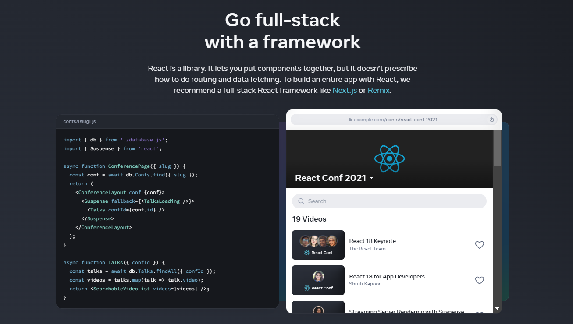

Slide 4

Why Starting with React Not
Next JS??

Slide 5
Key Features of Next JS??
Built in Optimization
Pre-Rendering
(SSG + SSR)
Next Level Data Fetching
Powerful Routing & Layouts
React Server Component
API Routes

Slide 6
Why Next JS over
React??

Slide 7




Slide 8


Slide 9


Feature | React | Next.js
Type | JavaScript library | React framework built on top of React library
Flexibility | Highly flexible and customizable | Less flexible due to opinionated structure
Learning Curve | Steeper learning curve | Easier to learn for those familiar with React
Features | Requires additional setup for routing, data fetching, SSR | Routing, data fetching, SSR built-in
Performance | Can be optimized, but requires effort | Improves performance out of the box
SEO | Requires additional work | SEO friendly due to server-side rendering
Use Cases | Wide range of web applications | Ideal for modern, performant web applications

Slide 10
Framework
Vs
Library

Slide 11
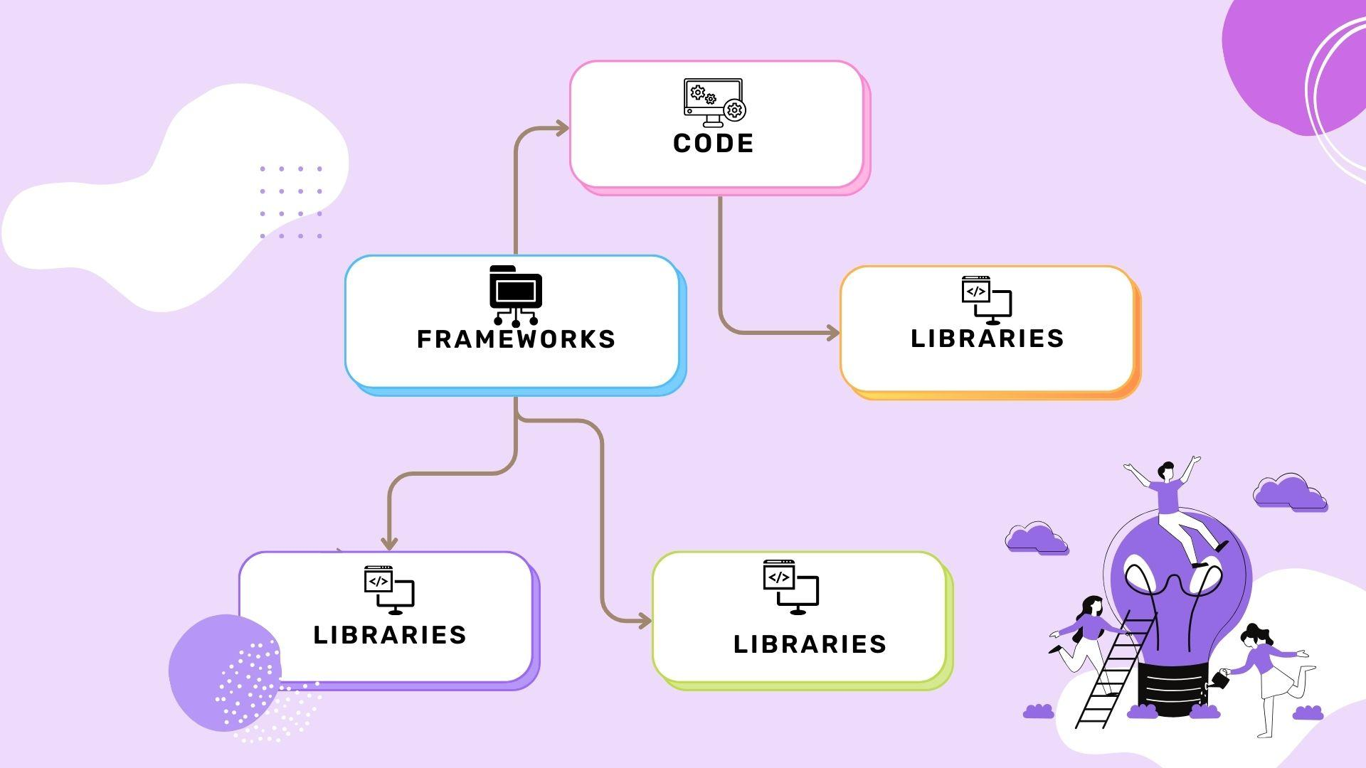

Slide 12
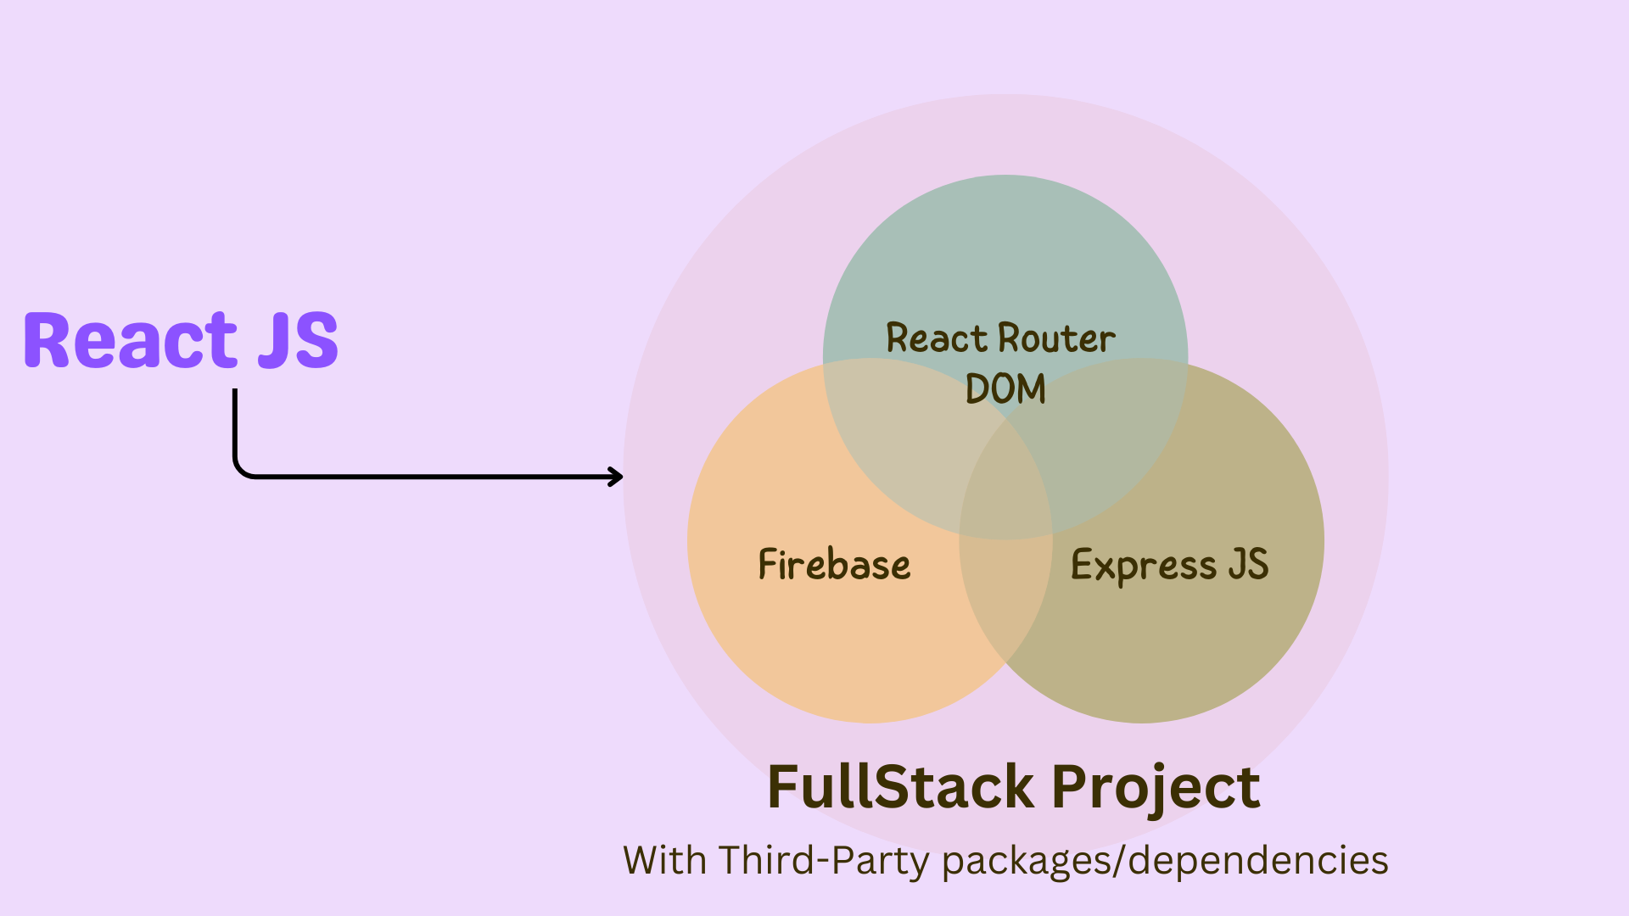


Slide 13
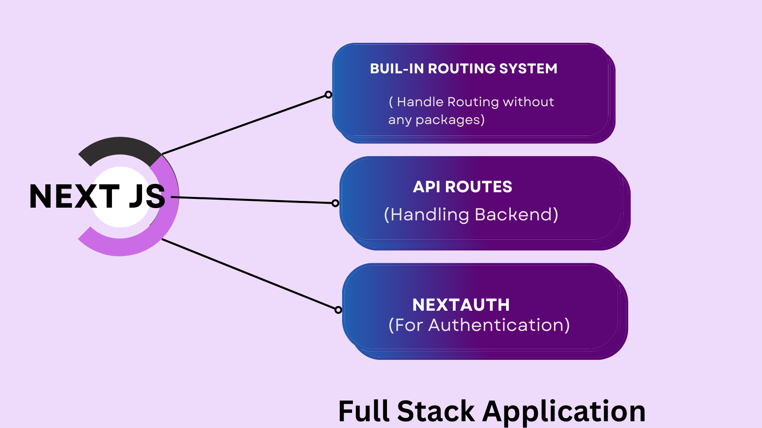
All in One

Slide 14

What is Rendering
Process of transforming code into the visual and interactive web pages that users see and interact with on their browsers.

Slide 15



Here's a breakdown of the key points of Rendering:
Input: HTML, CSS, and JavaScript code.
Process: The browser's rendering engine interprets this code.
Output: An interactive web page.
Output

Slide 16
Types of Rendering
Rendering
Client Side Rendering(CSR)
Pre-Rendering
Web page is rendered by the user's browser instead of the server
Process of generating a website's content or parts of it before a user requests them

Slide 17
Types of Rendering
Rendering
Client Side Rendering(CSR)
Pre-Rendering
Performance Optimization
Server Side
Rendering(SSR)
Static Site Generation(SSG)

Slide 18



Client Side Rendering
Browser / Client
Web Server

Slide 19
Server Side Rendering
Browser / Client
Web Server

Slide 20
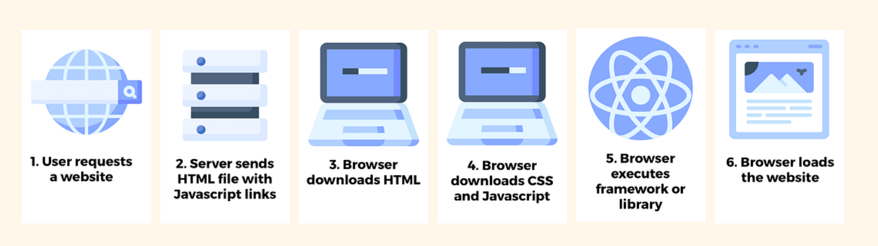
Client Side Rendering(CSR)

Slide 21
Types of Pre-Rendering
Pre-Rendering
Performance Optimization
Server Side
Rendering(SSR)
Static Site Generation(SSG)
web server generates the complete HTML for a page each time a user requests it.
website's HTML pages are pre-built at build time, before being deployed to a server.

Slide 22
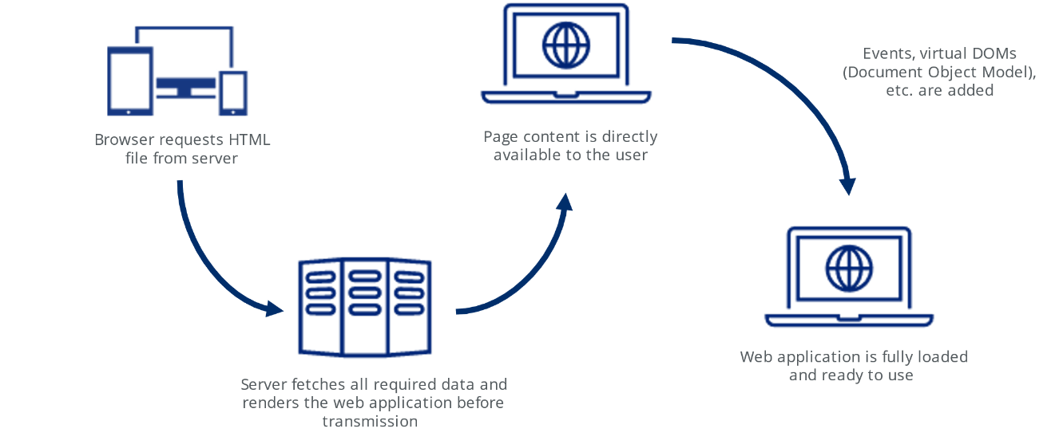
Server Side Rendering(SSR)
Process:
User requests a webpage.
Server receives the request and fetches any necessary data (like from a database).
Server uses the data and templates to generate the full HTML content of the page.
The complete HTML is sent to the user's browser for display.

Slide 23
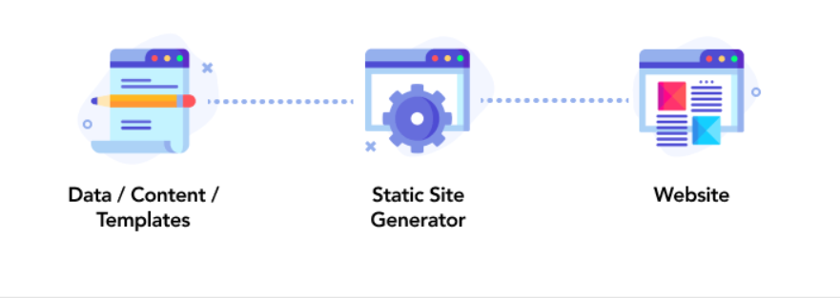
Static Site Generation(SSG)
Process:
During development, content and templates are used to generate the HTML for each page.
These pre-built HTML files are deployed to a web server.
When a user requests a page, the server simply delivers the corresponding static HTML file.

Slide 24
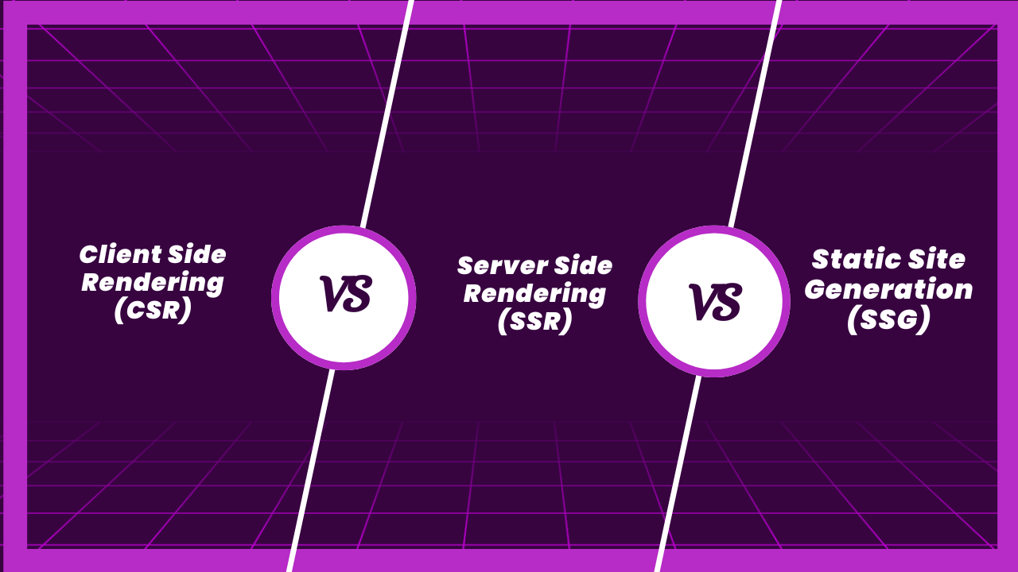

Slide 25
Feature | Client-Side Rendering (CSR) | Server-Side Rendering (SSR) | Static Site Generation (SSG)
Rendering Location | User's Browser | Web Server | Build Process (Pre-rendered)
Process | 1. User requests a page. 2. Server sends minimal HTML and JavaScript. 3. Browser downloads JavaScript and fetches data (optional). 4. JavaScript builds and displays the page content. | 1. User requests a page. 2. Server fetches data and generates full HTML content. 3. Server sends complete HTML to the user's browser. | 1. During development, content and templates are used to generate HTML for each page. 2. Pre-built HTML files are deployed to a server. 3. When a user requests a page, the server delivers the corresponding HTML file.
Benefits | Faster subsequent navigation within the same application Highly interactive and dynamic experiences | SEO friendly Faster initial load for users with slow internet (pre-built HTML) | Very fast load times Reduced server load Excellent SEO
Drawbacks | Slower initial load (downloads and executes JavaScript first) SEO challenges | . More server load (generating HTML for each request) Potentially slower for users with fast internet | Less flexibility for dynamic content (requires rebuild and redeploy)
Ideal for | Single-page applications (SPAs) Highly interactive and dynamic web experiences Offline functionality (with proper caching) | Content-heavy websites with SEO emphasis Complex applications with real-time data (e-commerce) Faster initial load for users with limited bandwidth | Websites with mostly static content (blogs, portfolios) Priority on fast loading times Minimal server load

Slide 26

Thank you!

